Slide 1


UNIVERSITY INSTITUTE OF ENGINEERING
COMPUTER SCIENCE ENGINEERING
Bachelor of Engineering (Computer Science & Engineering)
Subject Name: STATISTICAL METHODS USING R
Subject Code: 20SMT-460

Slide 2
Practice Questions

Slide 3
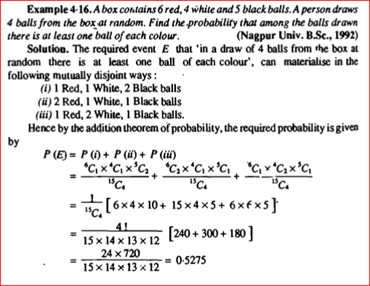

Slide 4
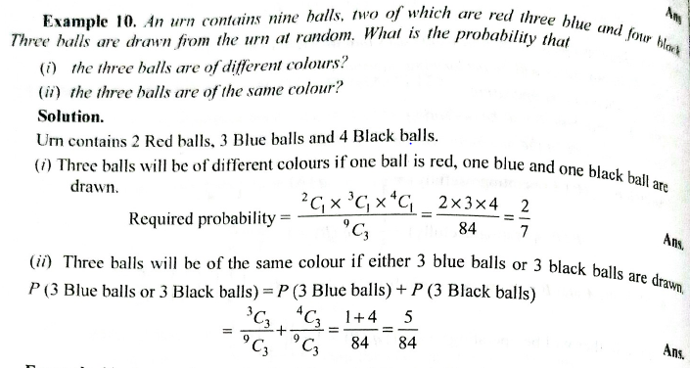

Slide 5
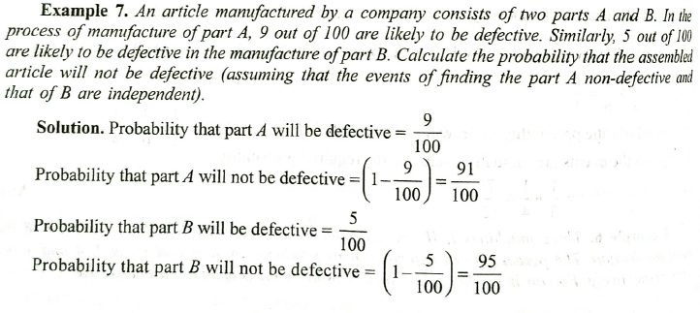

Slide 6
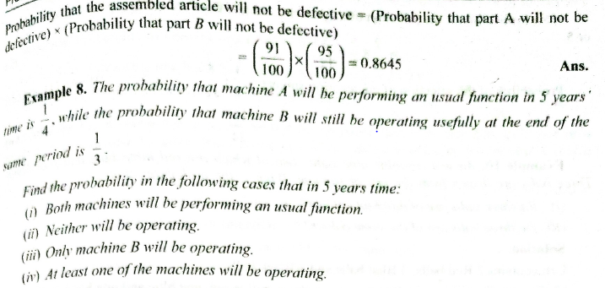

Slide 7
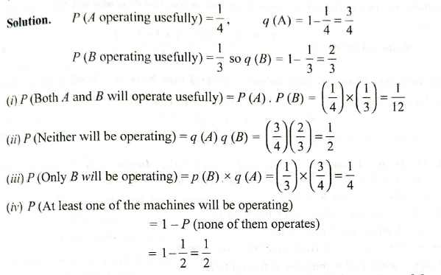

Slide 8
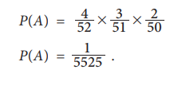
Three cards are drawn successively from a well-shuffled pack of 52 playing cards. Find the probability all three cards drawn successively is ace without replacing the card after each draw.
Solution:
Let A: all the three cards drawn are aces
At the first draw, there will be 4 aces among 52 cards. Having drawn an ace in the first draw, there will be 3 aces among 51 cards. Similarly, there will be 2 aces among 51 cards for the third draw.
Then,

Slide 9
Example: There are 13 boys and 6 girls in a class. Four students are selected randomly one after another from that class. Find the probability that: (i) all are girls, (ii) first two are boys and next are girls

Slide 10

Solution:
i. Suppose that
B: all the randomly selected students are girls
There will be 6 girls among 19 students, in total, while selecting the first student; there will be 5 girls among 18 students, in total, while selecting the second student; 4 girls among 17 students, in total, while selecting the third student; and 3 girls among the remaining 16 students, in total, while selecting the fourth student.
Then, by applying the Theorem-8.5 for simultaneous occurrence of these four events, it follows that

Slide 11

ii Suppose that
C: In the randomly selected students the first two are boys and the next are girls
There will be 13 boys among the 19 students, in total, while selecting the first student; there will be 12 boys among 18 students, in total, while selecting the second student; 6 girls among 17 students, in total, while selecting the third student; and 5 girls among the remaining 16 students, in total, while selecting the fourth student.
Then, by applying the Theorem 8.5 for simultaneous occurrence of these four events, it follows that

